Slide 1

Introduction to Bayesian Models
Steve Elston
Copyright 2018, 2019, 2020, 2021, 2022, 2023 2024, 2025, Stephen F Elston. All rights reserved.

Slide 2
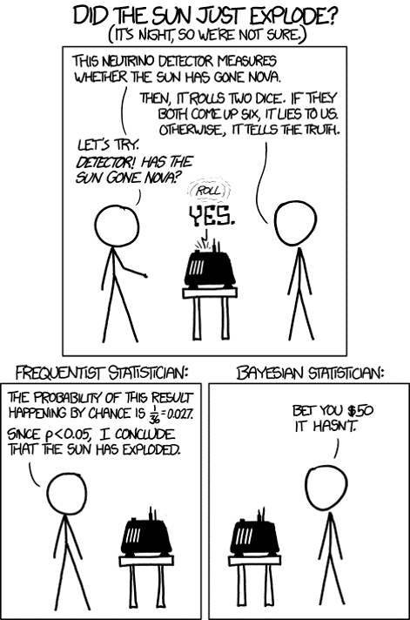
Introduction Bayesian Models Drawing from xkcd

Slide 3
Introduction Bayesian Models
Despite the long history, Bayesian models have not been used extensively until recently
Two traditions in statistics
Frequentist classical statistics we have been working with previously
Bayesian statistics
Limited use of Bayesian methods is a result of several difficulties
Rarely taught for much of the 20th Century
Specifying a prior distribution has proved a formidable intellectual obstacle
Modern Bayesian methods are often computationally intensive and have become practical only with cheap computing
Emergence of improved software and algorithms has resulted in wide and practical use to Bayesian methods

Slide 4
Introduction
Bayesian analysis is a contrast to frequentist methods
Frequentist statistics computes a point estimate and confidence interval from a sample
The objective of Bayesian analysis is to compute a posterior distribution
Inference can be performed on the posterior distribution by finding the maximum a postiori (MAP) value and a credible interval
The posterior distribution is said to quantify our current belief
Bayesian models allow expressing prior information in the form of a prior distribution
Update beliefs based on additional data or evidence
Frequentist models which must be recomputed from a complete sample

Slide 5
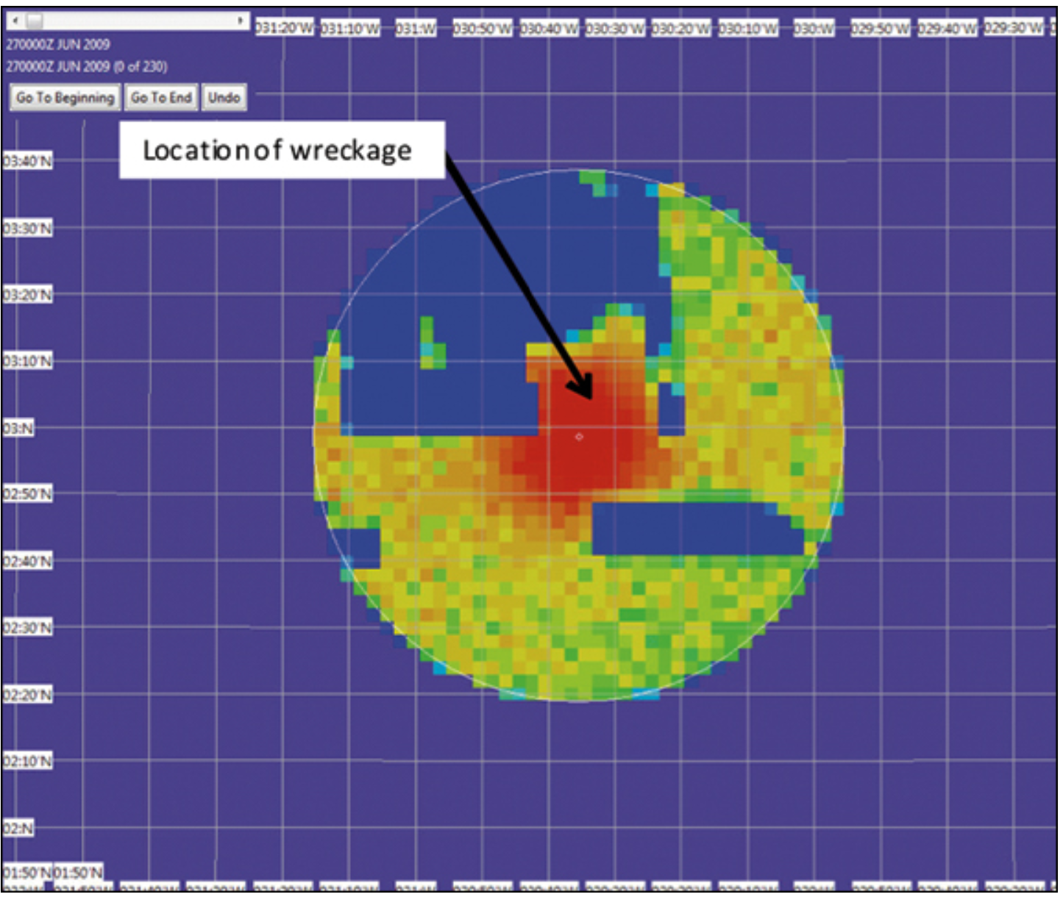
Bayesian Model Use Case
Bayesian methods made global headlines with the successful location of the missing Air France Flight 447
Aircraft had disappeared in little traveled area of the South Atlantic Ocean on June 1, 2009
Conventional location methods had failed to locate the wreckage; potential search area too large
Bayesian methods rapidly narrowed the prospective search area
Used ‘prior information’ on aircraft heading and time of satellite transmission
Posterior distribution of locations of Air France 447

Slide 6
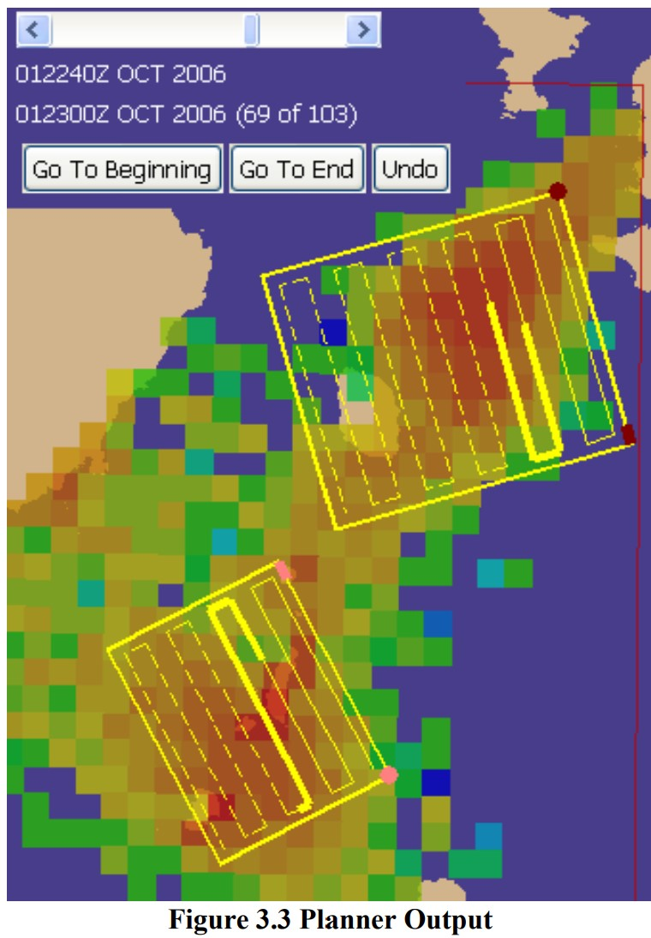
Bayesian Model Use Case
Kratzke, Stone and Frost developed an optimal search planner using Bayesian modeling for the US Coast Guard
Search areas concentrate on high posterior probability regions
Model accounts for current, wind, etc.
Screen shot from USCG search planner

Slide 7
Bayesian vs. Frequentist Views
With greater computational power and general acceptance, Bayes methods are now widely used
Among pragmatists
Some problems are better handled by frequentist methods
Some problems with Bayesian methods
Bayes models allow us to express prior information
Models that fall between these extremes are also in common use
Methods include the so-called empirical Bayes methods
See Empirical Bayes: Concepts and Methods by Bradley Efron for an introduction to the theory

Slide 8
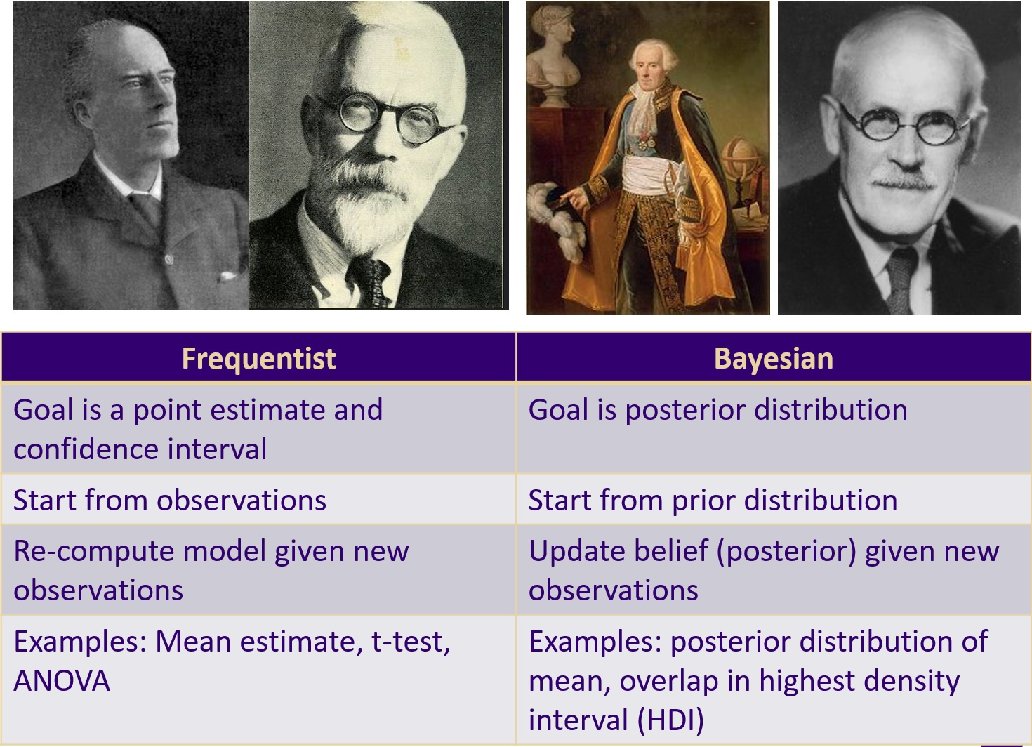
Bayesian vs. Frequentist Views
Can compare the contrasting frequentist and Bayesian approaches

Slide 9
Bayes Theorem

Slide 10
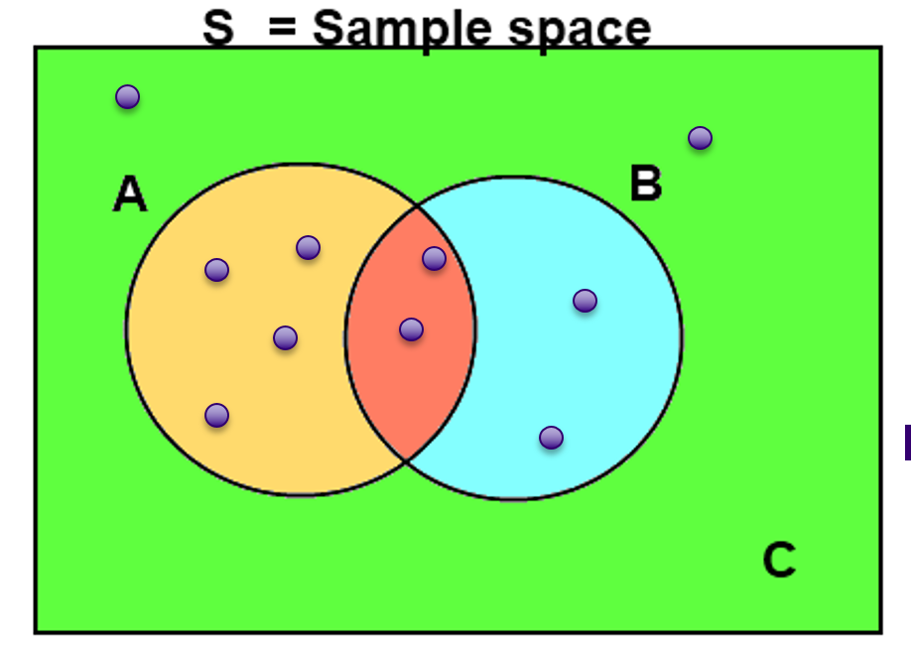
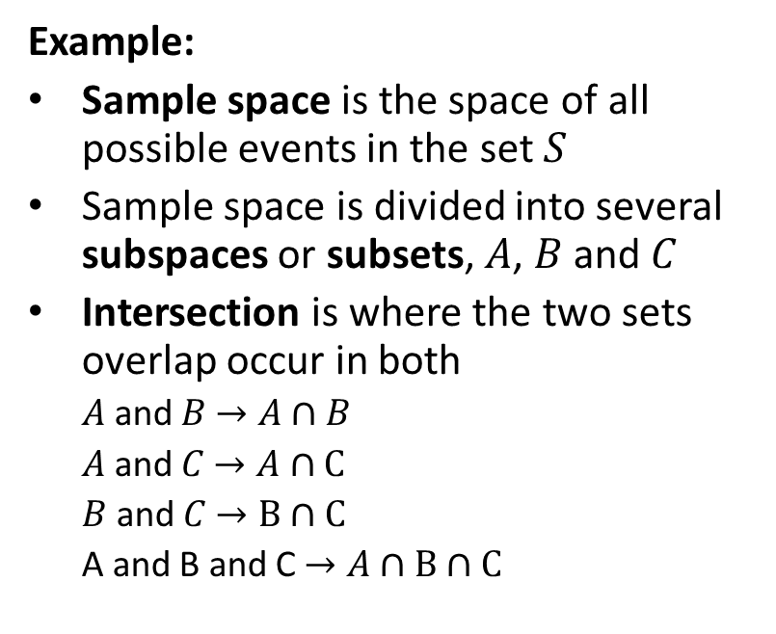
Properties of Conditional Probability
Example:
Sample space is the space of all possible events in the set $S$
Sample space is divided into several subspaces or subsets, $A$, $B$ and $C$
Intersection is where the two sets overlap occur in both
$A$ and $B$ $→A∩B$
$A$ and $C$ $→A∩C$
$B$ and $C$ $→B∩C$
A and B and C $→A∩B∩C$
Example of conditional probability of discrete events
credit, Wikipedia commons

Slide 11
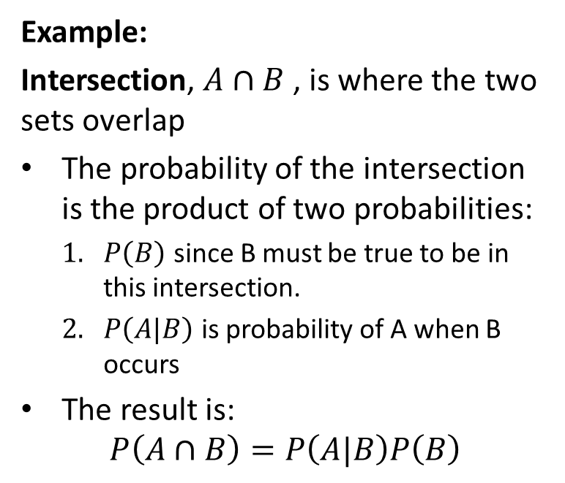
Properties of Conditional Probability
Example:
Intersection, $A∩B$ , is where the two sets overlap
The probability of the intersection is the product of two probabilities:
$P\left(B\right)$ since B must be true to be in this intersection.
$P\left(A|B\right)$ is probability of A when B occurs
The result is:
$$P\left(A∩B\right)=P\left(A|B\right)P\left(B\right)$$
Example of conditional probability of discrete events
credit, Wikipedia commons

Slide 12
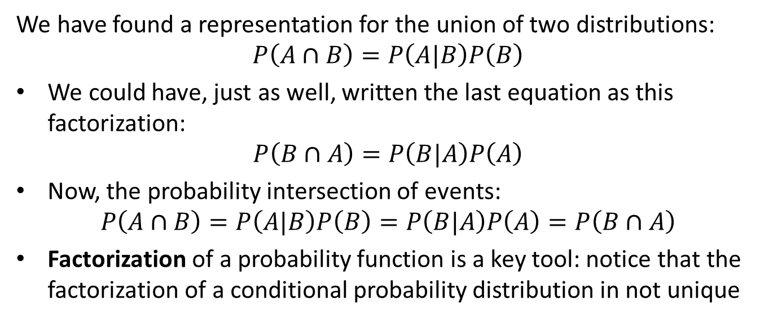
Properties of Conditional Probability
We have found a representation for the union of two distributions:
$$P\left(A∩B\right)=P\left(A|B\right)P\left(B\right)$$
We could have, just as well, written the last equation as this factorization:
$$P\left(B∩A\right)=P\left(B|A\right)P\left(A\right)$$
Now, the probability intersection of events:
$$P\left(A∩B\right)=P\left(A|B\right)P\left(B\right)=P\left(B|A\right)P\left(A\right)=P\left(B∩A\right)$$
Factorization of a probability function is a key tool: notice that the factorization of a conditional probability distribution in not unique

Slide 13
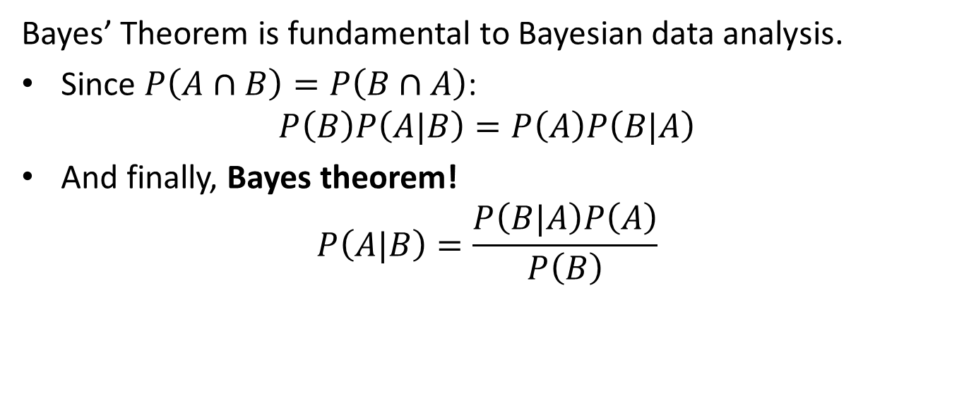
Review of Bayes Theorem
Bayes’ Theorem is fundamental to Bayesian data analysis.
Since $P\left(A∩B\right)=P\left(B∩A\right)$:
$$P\left(B\right)P\left(A|B\right)=P\left(A\right)P\left(B|A\right)$$
And finally, Bayes theorem!
$$P\left(A|B\right)=\frac{P\left(B|A\right)P\left(A\right)}{P\left(B\right)}$$

Slide 14
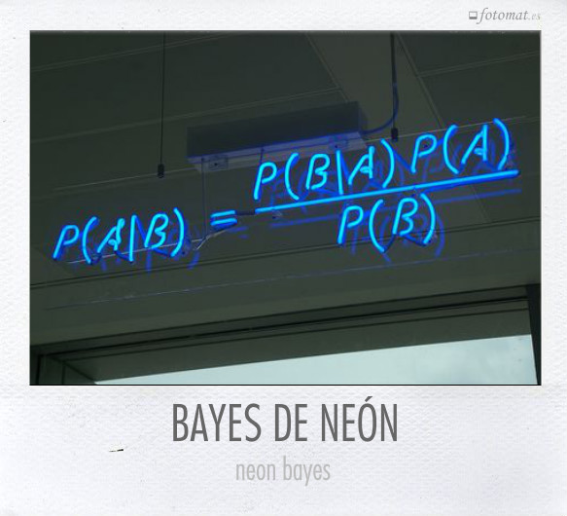
Bayes Theorem
Bayes Theorem!

Slide 15
Marginal Distribution

Slide 16
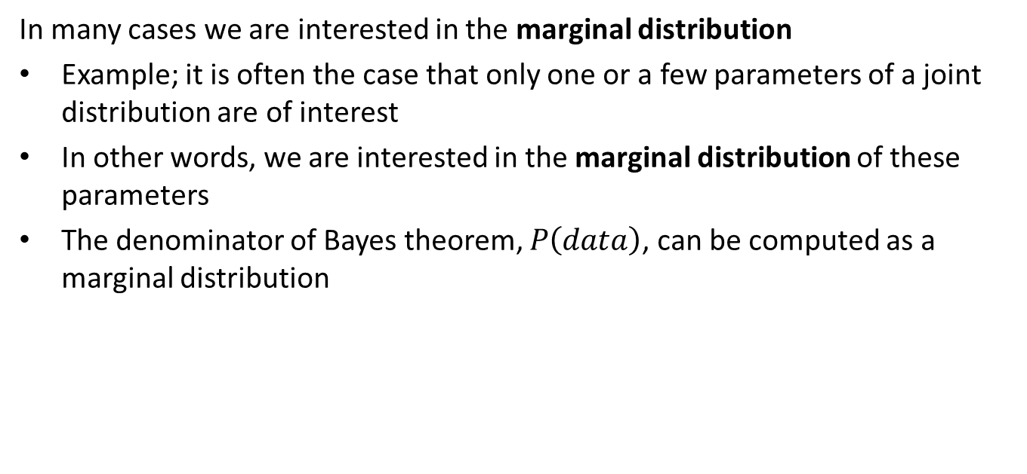
Marginal Distributions
In many cases we are interested in the marginal distribution
Example; it is often the case that only one or a few parameters of a joint distribution are of interest
In other words, we are interested in the marginal distribution of these parameters
The denominator of Bayes theorem, $P\left(data\right)$, can be computed as a marginal distribution

Slide 17
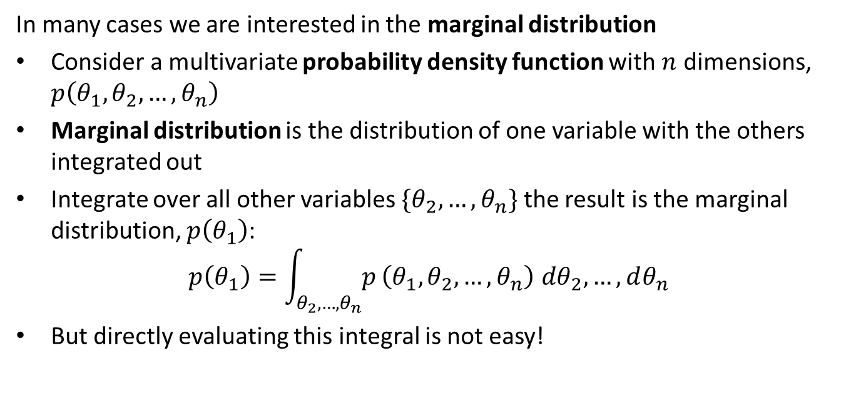
Marginal Distributions
In many cases we are interested in the marginal distribution
Consider a multivariate probability density function with $n$ dimensions, $p\left(θ_{1},θ_{2},…,θ_{n}\right)$
Marginal distribution is the distribution of one variable with the others integrated out
Integrate over all other variables $\{θ_{2},…,θ_{n}\}$ the result is the marginal distribution, $p\left(θ_{1}\right)$:
$$p\left(θ_{1}\right)=\int_{θ_{2},…,θ_{n}}^{​}{p}\left(θ_{1},θ_{2},…,θ_{n}\right) dθ_{2},…,dθ_{n}$$
But directly evaluating this integral is not easy!

Slide 18
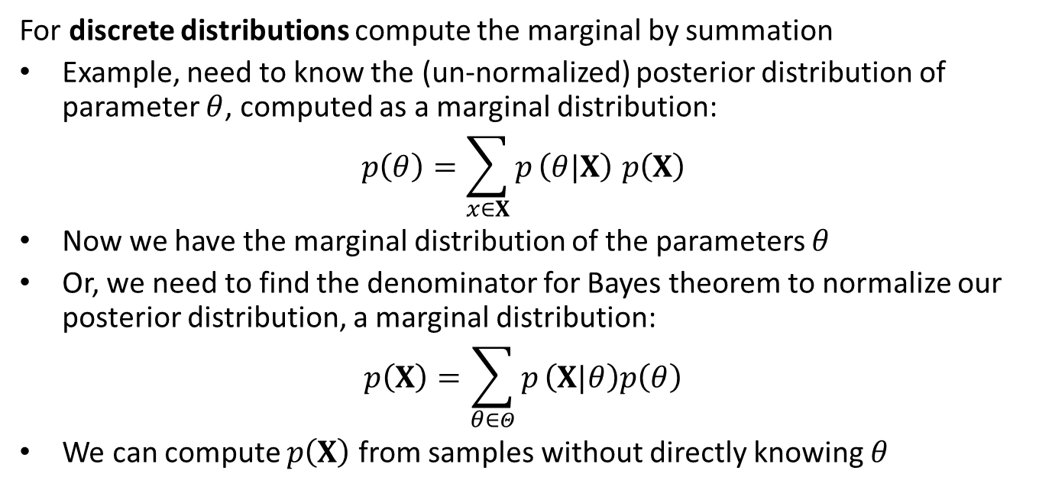
Marginal Distributions
For discrete distributions compute the marginal by summation
Example, need to know the (un-normalized) posterior distribution of parameter $θ$, computed as a marginal distribution:
$$p\left(θ\right)=\sum_{x∈X}^{​}{p}\left(θ|X\right) p\left(X\right)$$
Now we have the marginal distribution of the parameters $θ$
Or, we need to find the denominator for Bayes theorem to normalize our posterior distribution, a marginal distribution:
$$p\left(X\right)=\sum_{θ∈Θ}^{​}{p}\left(X|θ\right)p\left(θ\right)$$
We can compute $p\left(X\right)$ from samples without directly knowing $θ$

Slide 19
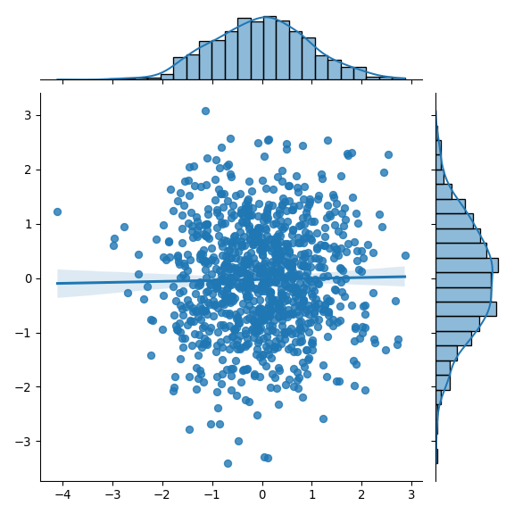
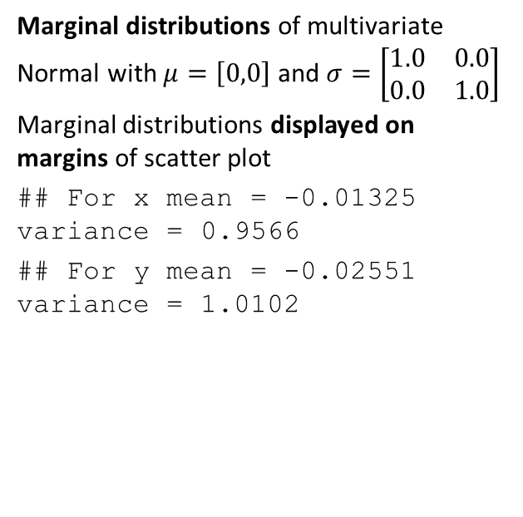
Example: Marginal Distribution
Marginal distributions of multivariate Normal with $μ=\left[0,0\right]$ and $σ=\left[\begin{matrix}1.0 & 0.0 \\ 0.0 & 1.0\end{matrix}\right]$
Marginal distributions displayed on margins of scatter plot
## For x mean = -0.01325 variance = 0.9566 ## For y mean = -0.02551 variance = 1.0102

Slide 20
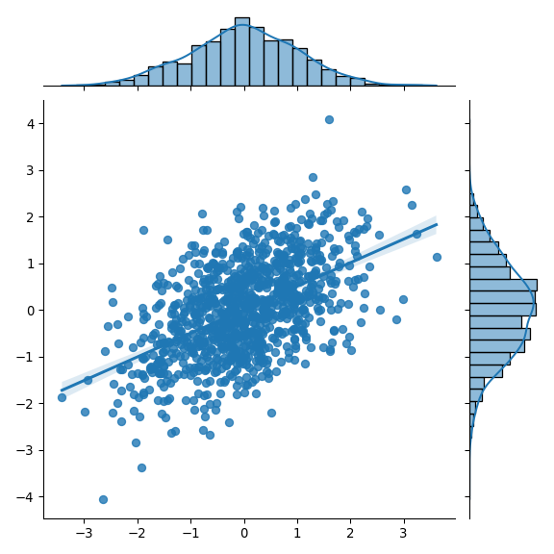
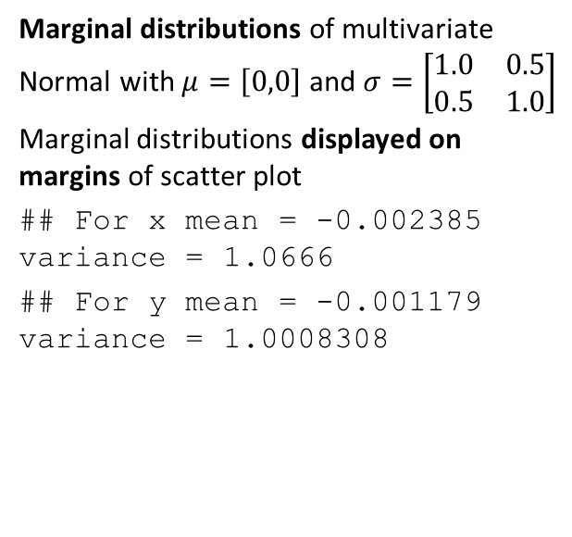
Example: Marginal Distribution
Marginal distributions of multivariate Normal with $μ=\left[0,0\right]$ and $σ=\left[\begin{matrix}1.0 & 0.5 \\ 0.5 & 1.0\end{matrix}\right]$
Marginal distributions displayed on margins of scatter plot
## For x mean = -0.002385 variance = 1.0666 ## For y mean = -0.001179 variance = 1.0008308

Slide 21
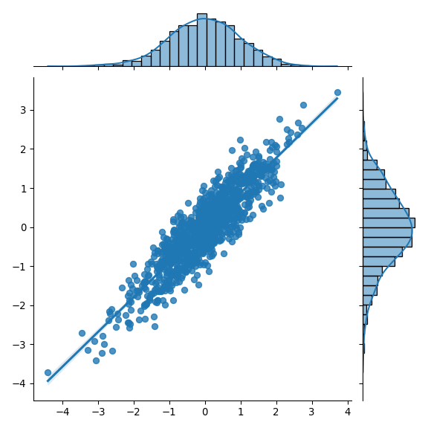
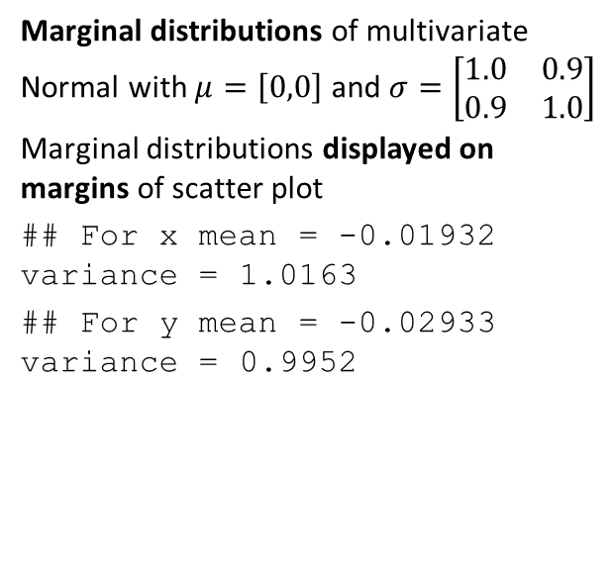
Example: Marginal Distribution
Marginal distributions of multivariate Normal with $μ=\left[0,0\right]$ and $σ=\left[\begin{matrix}1.0 & 0.9 \\ 0.9 & 1.0\end{matrix}\right]$
Marginal distributions displayed on margins of scatter plot
## For x mean = -0.01932 variance = 1.0163 ## For y mean = -0.02933 variance = 0.9952

Slide 22
Interpreting Bayes Models

Slide 23
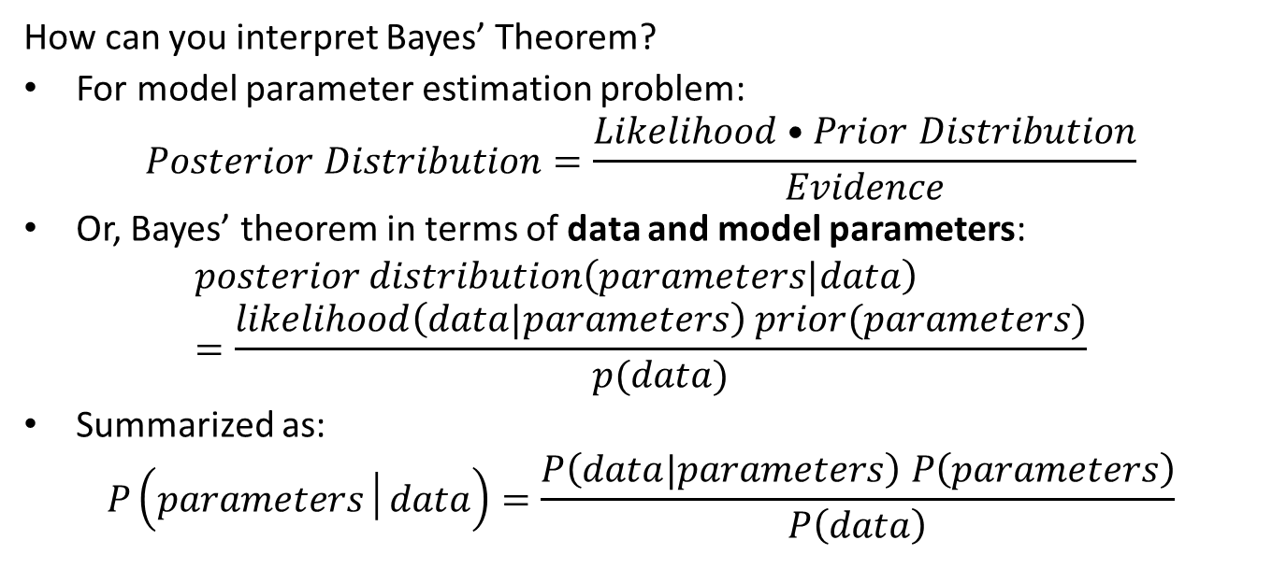
Interpreting Bayes Theorem
How can you interpret Bayes’ Theorem?
For model parameter estimation problem:
$$Posterior Distribution=\frac{Likelihood•Prior Distribution}{Evidence}$$
Or, Bayes’ theorem in terms of data and model parameters:
$$posterior distribution\left(parameters|data\right)=\frac{likelihood\left(data|parameters\right) prior(parameters)}{p(data)}$$
Summarized as:
$$P\left(parameters│data\right)=\frac{P\left(data|parameters\right) P\left(parameters\right)}{P\left(data\right)}$$

Slide 24
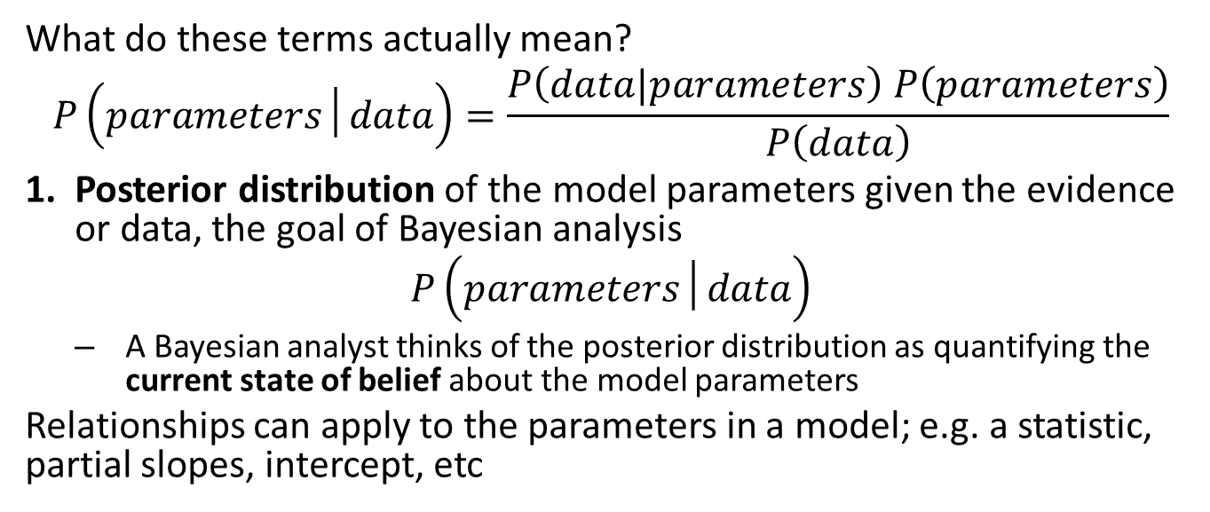
Interpreting Bayes Theorem
What do these terms actually mean?
$$P\left(parameters│data\right)=\frac{P\left(data|parameters\right) P\left(parameters\right)}{P\left(data\right)}$$
Posterior distribution of the model parameters given the evidence or data, the goal of Bayesian analysis
$$P\left(parameters│data\right)$$
A Bayesian analyst thinks of the posterior distribution as quantifying the current state of belief about the model parameters
Relationships can apply to the parameters in a model; e.g. a statistic, partial slopes, intercept, etc

Slide 25
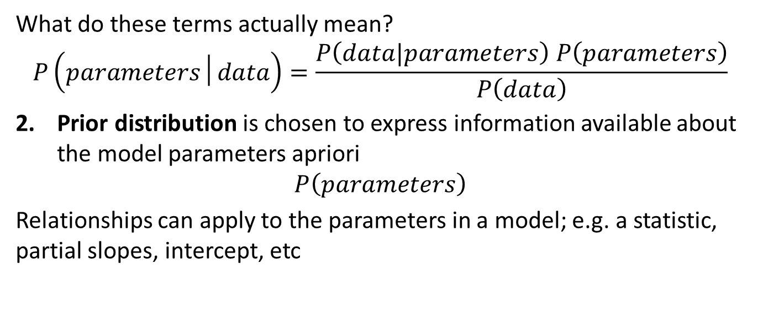
Interpreting Bayes Theorem
What do these terms actually mean?
$$P\left(parameters│data\right)=\frac{P\left(data|parameters\right) P\left(parameters\right)}{P\left(data\right)}$$
Prior distribution is chosen to express information available about the model parameters apriori
$$P\left(parameters\right)$$
Relationships can apply to the parameters in a model; e.g. a statistic, partial slopes, intercept, etc

Slide 26
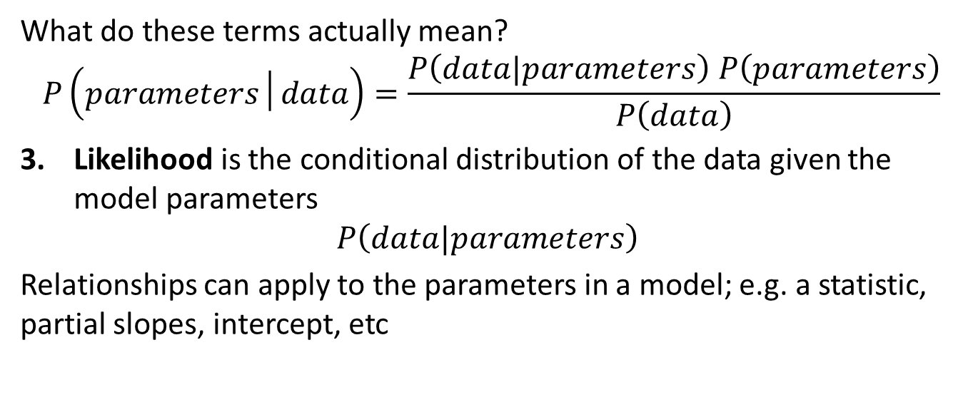
Interpreting Bayes Theorem
What do these terms actually mean?
$$P\left(parameters│data\right)=\frac{P\left(data|parameters\right) P\left(parameters\right)}{P\left(data\right)}$$
Likelihood is the conditional distribution of the data given the model parameters
$$P\left(data|parameters\right)$$
Relationships can apply to the parameters in a model; e.g. a statistic, partial slopes, intercept, etc

Slide 27
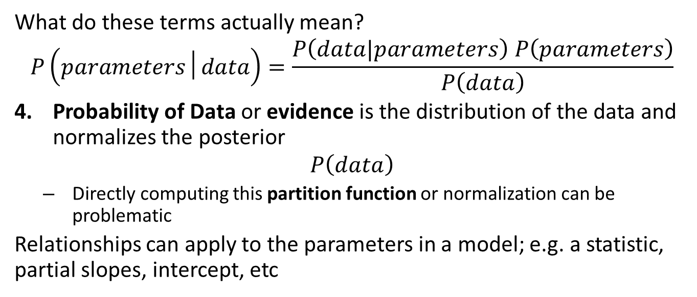
Interpreting Bayes Theorem
What do these terms actually mean?
$$P\left(parameters│data\right)=\frac{P\left(data|parameters\right) P\left(parameters\right)}{P\left(data\right)}$$
Probability of Data or evidence is the distribution of the data and normalizes the posterior
$$P\left(data\right)$$
Directly computing this partition function or normalization can be problematic
Relationships can apply to the parameters in a model; e.g. a statistic, partial slopes, intercept, etc

Slide 28
Applying Bayes Models

Slide 29
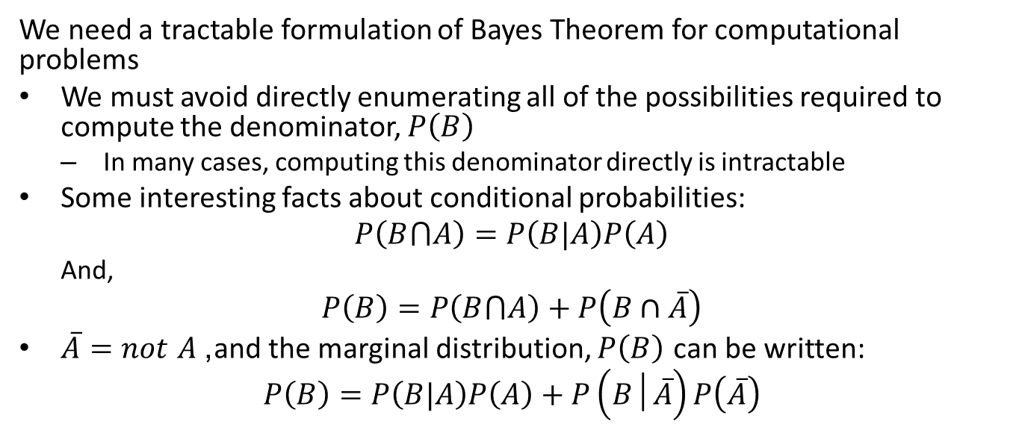
Applying Bayes Theorem
We need a tractable formulation of Bayes Theorem for computational problems
We must avoid directly enumerating all of the possibilities required to compute the denominator, $P\left(B\right)$
In many cases, computing this denominator directly is intractable
Some interesting facts about conditional probabilities:
$$P\left(B⋂A\right)=P\left(B|A\right)P\left(A\right)$$
And,
$$P\left(B\right)=P\left(B⋂A\right)+P\left(B∩\overline{A}\right)$$
$\overset{‾}{A}=not A$, and the marginal distribution, $P\left(B\right)$ can be written:
$$P\left(B\right)=P\left(B|A\right)P\left(A\right)+P\left(B│\overset{‾}{A}\right)P\left(\overset{‾}{A}\right)$$

Slide 30
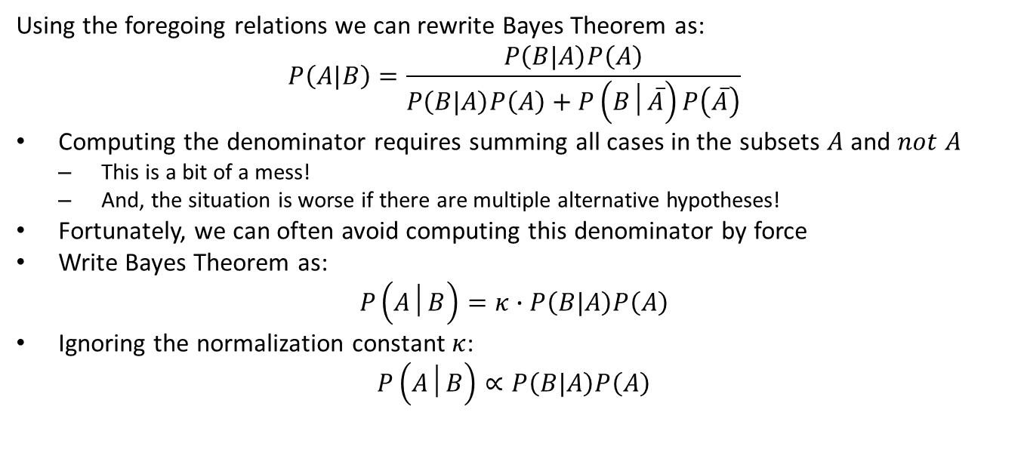
Applying Bayes Theorem
Using the foregoing relations we can rewrite Bayes Theorem as:
$$P\left(A|B\right)=\frac{P\left(B|A\right)P\left(A\right)}{P\left(B|A\right)P\left(A\right)+P\left(B│\overset{‾}{A}\right)P\left(\overset{‾}{A}\right)}$$
Computing the denominator requires summing all cases in the subsets $A$ and $not A$
This is a bit of a mess!
And, the situation is worse if there are multiple alternative hypotheses!
Fortunately, we can often avoid computing this denominator by force
Write Bayes Theorem as:
$$P\left(A│B\right)=κ∙P\left(B|A\right)P\left(A\right)$$
Ignoring the normalization constant $κ$:
$$P\left(A│B\right)∝P\left(B|A\right)P\left(A\right)$$

Slide 31
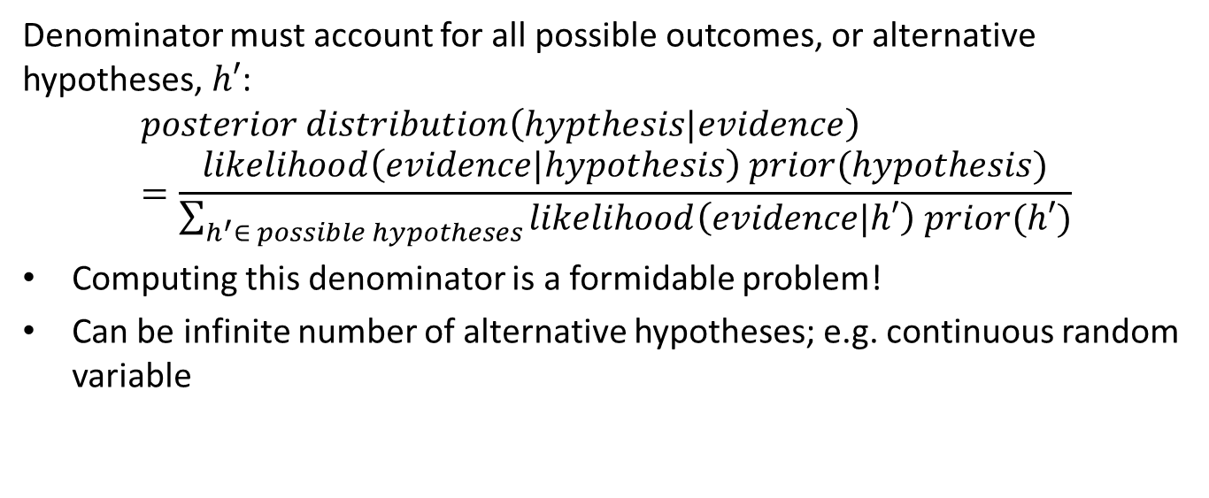
Interpreting Bayes Theorem
Denominator must account for all possible outcomes, or alternative hypotheses, $h′$:
$$posterior distribution\left(hypthesis|evidence\right)=\frac{likelihood\left(evidence|hypothesis\right) prior(hypothesis)}{\sum_{h^{′}∈ possible hypotheses}{likelihood\left(evidence|h′\right) prior(h′)}}$$
Computing this denominator is a formidable problem!
Can be infinite number of alternative hypotheses; e.g. continuous random variable

Slide 32
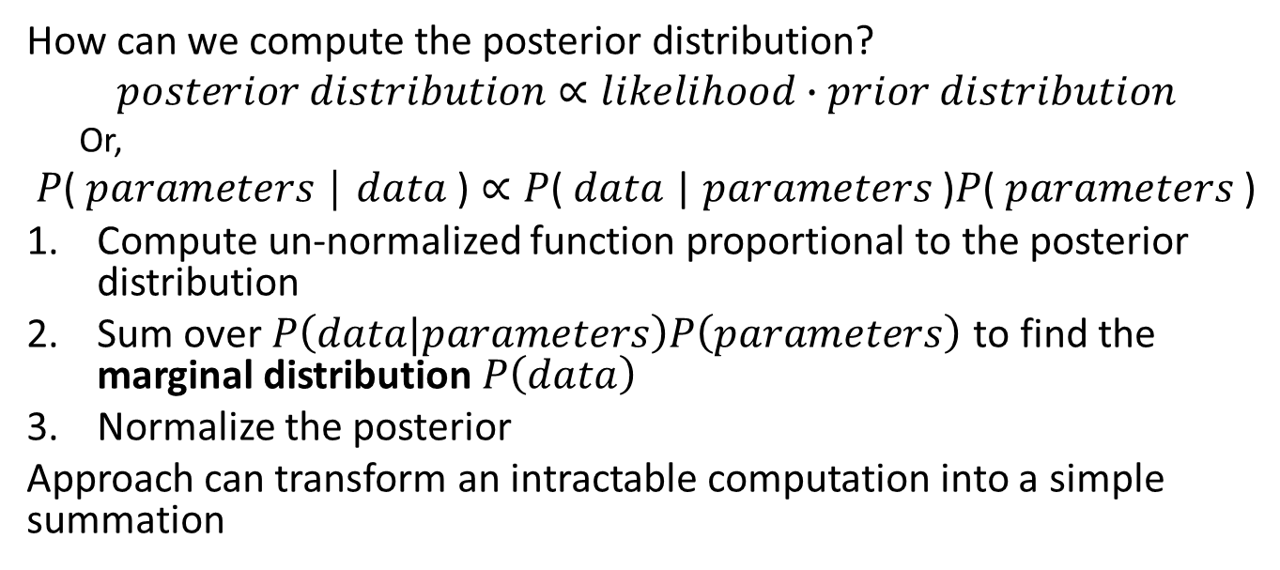
Simplified Relationship for Bayes Theorem
How can we compute the posterior distribution?
$$posterior distribution∝likelihood∙prior distribution$$
Or,
$$\text{P}\text{( }\text{parameters} \text{│ }\text{data} \text{)}∝\text{P}\text{( }\text{data} \text{| }\text{parameters} \text{)}\text{P}\text{( }\text{parameters} \text{)}$$
Compute un-normalized function proportional to the posterior distribution
Sum over $P\left(data|parameters\right)P\left(parameters\right)$ to find the marginal distribution $P\left(data\right)$
Normalize the posterior
Approach can transform an intractable computation into a simple summation

Slide 33
Workflow for Bayes Modeling

Slide 34
Bayesian Workflow
The goal of a Bayesian analysis is computing and performing inference on the posterior distribution of the model parameters, generally following these steps:
Identify data relevant to the research question
Define a sampling plan for the data, need not be collected in a single batch
Define the likelihood model; e.g. regression model with Normal likelihood
Specify a prior distribution of the model parameters

Slide 35
Bayesian Workflow
The goal of a Bayesian analysis is computing and performing inference on the posterior distribution of the model parameters, generally following these steps:
Use the Bayesian inference formula to compute posterior distribution of the model parameters
Update the posterior as data is observed
Perform inference on the posterior; e.g. compute MAP and credible interval
Simulate from the posterior distribution, predictions from the model.

Slide 36
Updating Bayesian Models
Updating belief when new evidence becomes available is a major advantage of Bayesian models
In contrast, frequentist models must be recomputed when new data becomes available
The previous posterior serves as a prior for model updates
The posterior of a Bayesian model with no evidence is the prior

Slide 37
Updating Bayesian Models
Updating belief when new evidence becomes available is a major advantage of Bayesian models
Current belief, or posterior distribution, used as prior
Compute likelihood for new evidence (new data) only
Updated posterior is updated belief
$$P\left(parameters│data\right)=\frac{P\left(data|parameters\right) P\left(parameters\right)}{P\left(data\right)}$$

Slide 38
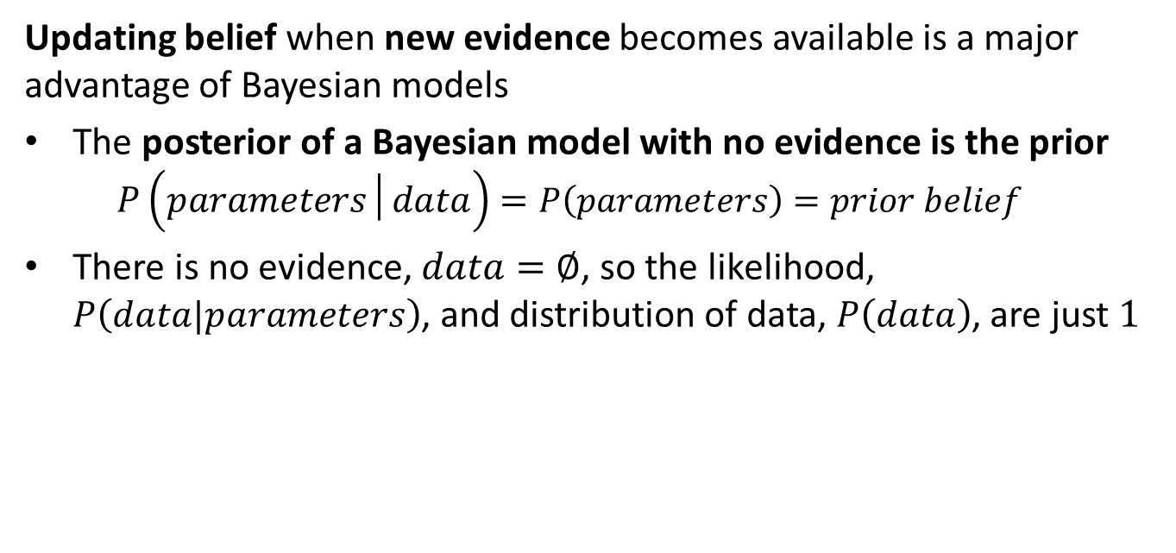
Updating Bayesian Models
Updating belief when new evidence becomes available is a major advantage of Bayesian models
The posterior of a Bayesian model with no evidence is the prior
$$P\left(parameters│data\right)=P\left(parameters\right)=prior belief$$
There is no evidence, $data=∅$, so the likelihood, $P\left(data|parameters\right)$, and distribution of data, $P\left(data\right)$, are just $1$

Slide 39
Prior Distributions

Slide 40
How can you choose a prior?
The choice of the prior is a difficult, and potentially vexing, problem when performing Bayesian analysis
The need to choose a prior has often been cited as a reason why Bayesian models are impractical
General guidance is that a prior must be convincing to a skeptical audience
Tend to use vague or less informative priors in practice
In practice, given a bit of data Bayesian models are robust to choice of prior

Slide 41
How can you choose a prior?
Some possible approaches to prior selection include:
Use empirical information
Empirical Bayes estimates prior from sample of observations
Apply domain knowledge to determine a reasonable distribution
Information from existing work
Example, the viable range of parameter values computed from physical principles
Example, a known price range for some asset
If there is poor prior knowledge for the problem a non-informative prior can be used
One possibility is a Uniform distribution. But be careful, a uniform prior is informative because of limits on the values!
Other options include the Jefferys’ prior, but hard to work with

Slide 42
How can you choose a prior?
How can we use empirical information to estimate the parameters of the prior distribution?
Deriving a prior distribution in this manner is called empirical Bayes
Estimation of useful priors has become practical with large modern data sets
Empirical Bayes approach is often applied in practice
Some Bayesian theoreticians do not consider this a Bayesian approach at all!

Slide 43
How can you choose a prior?
How can we use empirical information to estimate the parameters of the prior distribution?
Deriving a prior distribution in this manner is called empirical Bayes
Example, need a prior distribution of home prices per square foot by location
Use pooled information to compute distribution of prices for all locations
Use the prior with specific evidence by locations, property characteristics, etc. to compute posteriors by location
Is example of hierarchical model
Typically, a less informative prior distribution is used than the actual empirical distribution so the model is not overly constrained

Slide 44
Conjugate Prior Distributions
A conjugate prior is an analytically and computationally simple choice of prior distribution
The posterior distribution computed from the product of a likelihood function and a conjugate prior is in the same family as the prior
Attractive idea for cases where the conjugate distribution exists
Analytic results can be computed
The posterior is a known distribution
But there are many practical cases where a conjugate prior is not used
We will address more general methods later

Slide 45
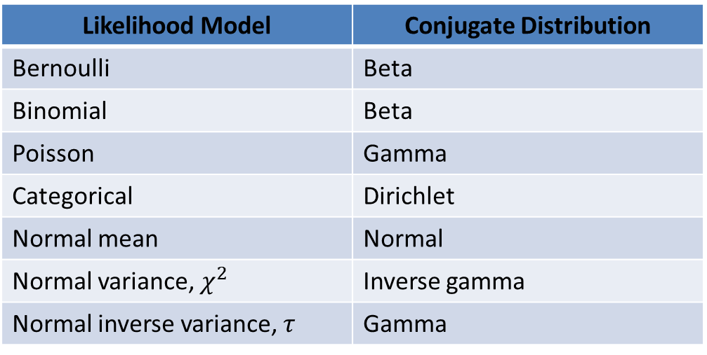
Conjugate Prior Distributions
A conjugate prior is an analytically and computationally simple choice of prior distribution
Likelihood Model | Conjugate Distribution
Bernoulli | Beta
Binomial | Beta
Poisson | Gamma
Categorical | Dirichlet
Normal mean | Normal
Normal variance, $χ^{2}$ | Inverse gamma
Normal inverse variance, $τ$ | Gamma

Slide 46
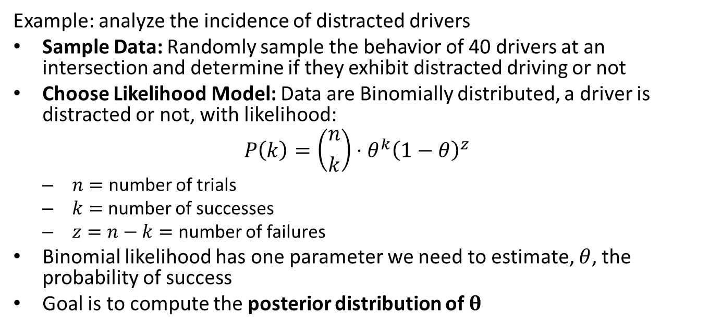
Working with a Conjugate Prior
Example: analyze the incidence of distracted drivers
Sample Data: Randomly sample the behavior of 40 drivers at an intersection and determine if they exhibit distracted driving or not
Choose Likelihood Model: Data are Binomially distributed, a driver is distracted or not, with likelihood:
$$P\left(k\right)=\left({n \atop k}\right)⋅θ^{k}{\left(1−θ\right)}^{z}$$
$n=$ number of trials
$k=$ number of successes
$z=n−k=$ number of failures
Binomial likelihood has one parameter we need to estimate, $θ$, the probability of success
Goal is to compute the posterior distribution of $θ$

Slide 47
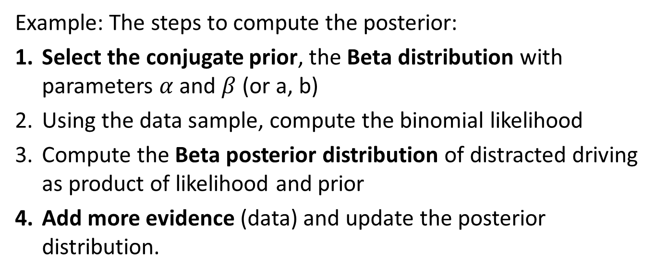
Working with a Conjugate Prior
Example: The steps to compute the posterior:
Select the conjugate prior, the Beta distribution with parameters $α$ and $β$ (or a, b)
Using the data sample, compute the binomial likelihood
Compute the Beta posterior distribution of distracted driving as product of likelihood and prior
Add more evidence (data) and update the posterior distribution.

Slide 48
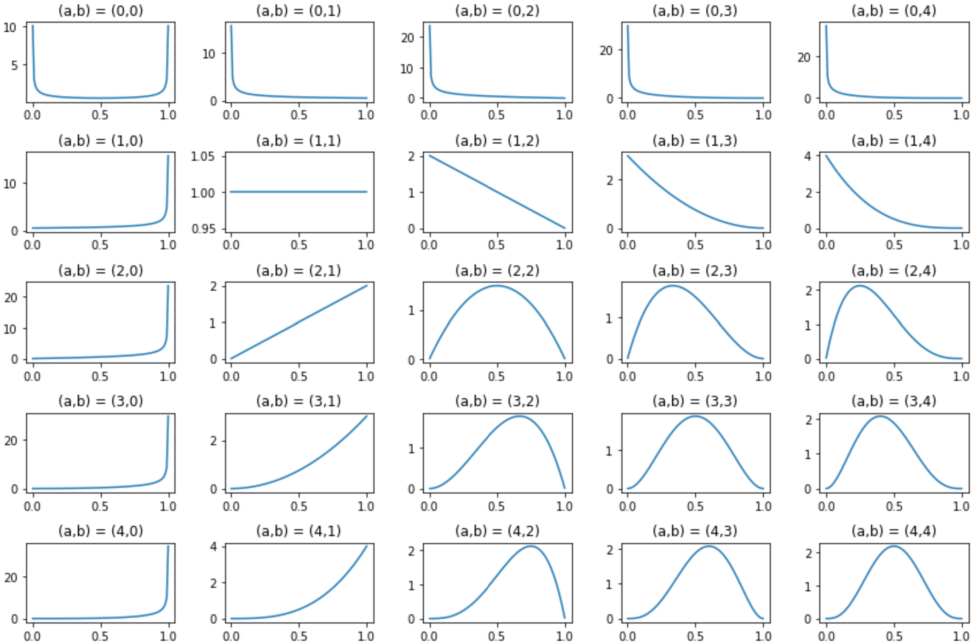
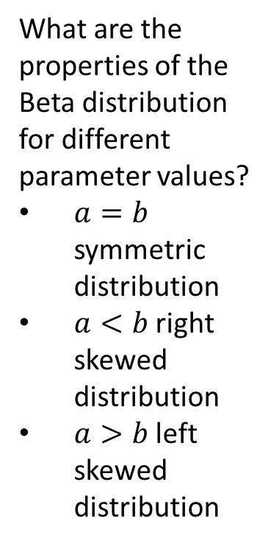
Working with a Conjugate Prior
What are the properties of the Beta distribution for different parameter values?
$a=b$ symmetric distribution
$a<b$ right skewed distribution
$a>b$ left skewed distribution

Slide 49
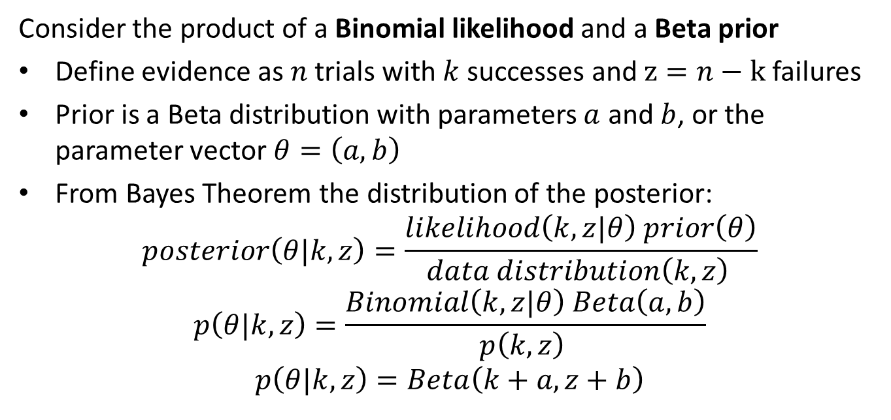
Working with a Conjugate Prior
Consider the product of a Binomial likelihood and a Beta prior
Define evidence as $n$ trials with $k$ successes and $z=n−k$ failures
Prior is a Beta distribution with parameters $a$ and $b$, or the parameter vector $θ=\left(a,b\right)$
From Bayes Theorem the distribution of the posterior:
$$posterior\left(θ|k,z\right)=\frac{likelihood\left(k,z|θ\right) prior\left(θ\right)}{data distribution\left(k,z\right) }$$
$$p\left(θ|k,z\right)=\frac{Binomial\left(k,z|θ\right) Beta\left(a,b\right)}{p\left(k,z\right) }$$
$$p\left(θ|k,z\right)=Beta\left(k+a,z+b\right)$$

Slide 50
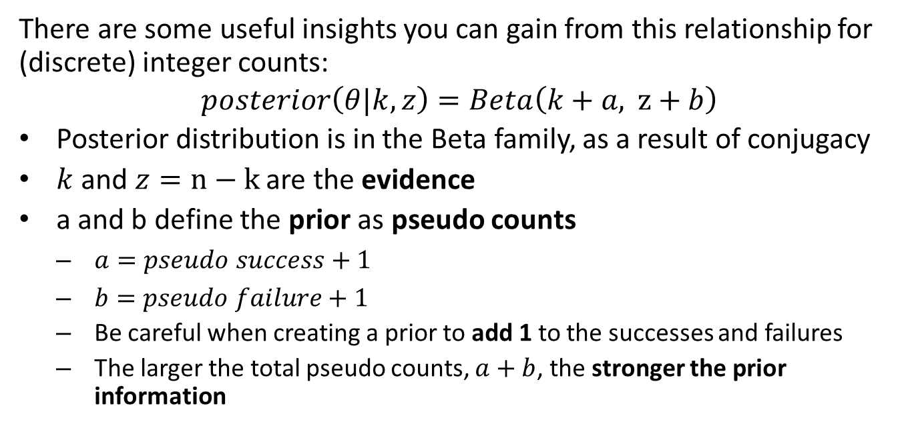
Working with a Conjugate Prior
There are some useful insights you can gain from this relationship for (discrete) integer counts:
$$posterior\left(θ|k,z\right)=Beta\left(k+a, z+b\right)$$
Posterior distribution is in the Beta family, as a result of conjugacy
$k$ and $z=n−k$ are the evidence
a and b define the prior as pseudo counts
$a=pseudo success+1$
$b=pseudo failure+1$
Be careful when creating a prior to add 1 to the successes and failures
The larger the total pseudo counts, $a+b$, the stronger the prior information

Slide 51
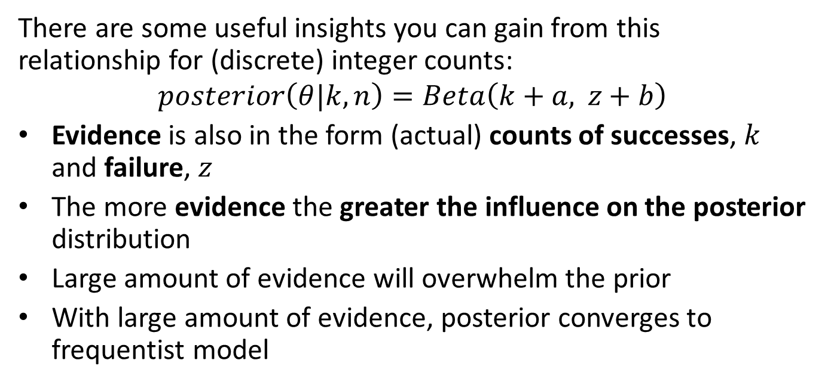
Working with a Conjugate Prior
There are some useful insights you can gain from this relationship for (discrete) integer counts:
$$posterior\left(θ|k,n\right)=Beta\left(k+a, z+b\right)$$
Evidence is also in the form (actual) counts of successes, $k$ and failure, $z$
The more evidence the greater the influence on the posterior distribution
Large amount of evidence will overwhelm the prior
With large amount of evidence, posterior converges to frequentist model

Slide 52
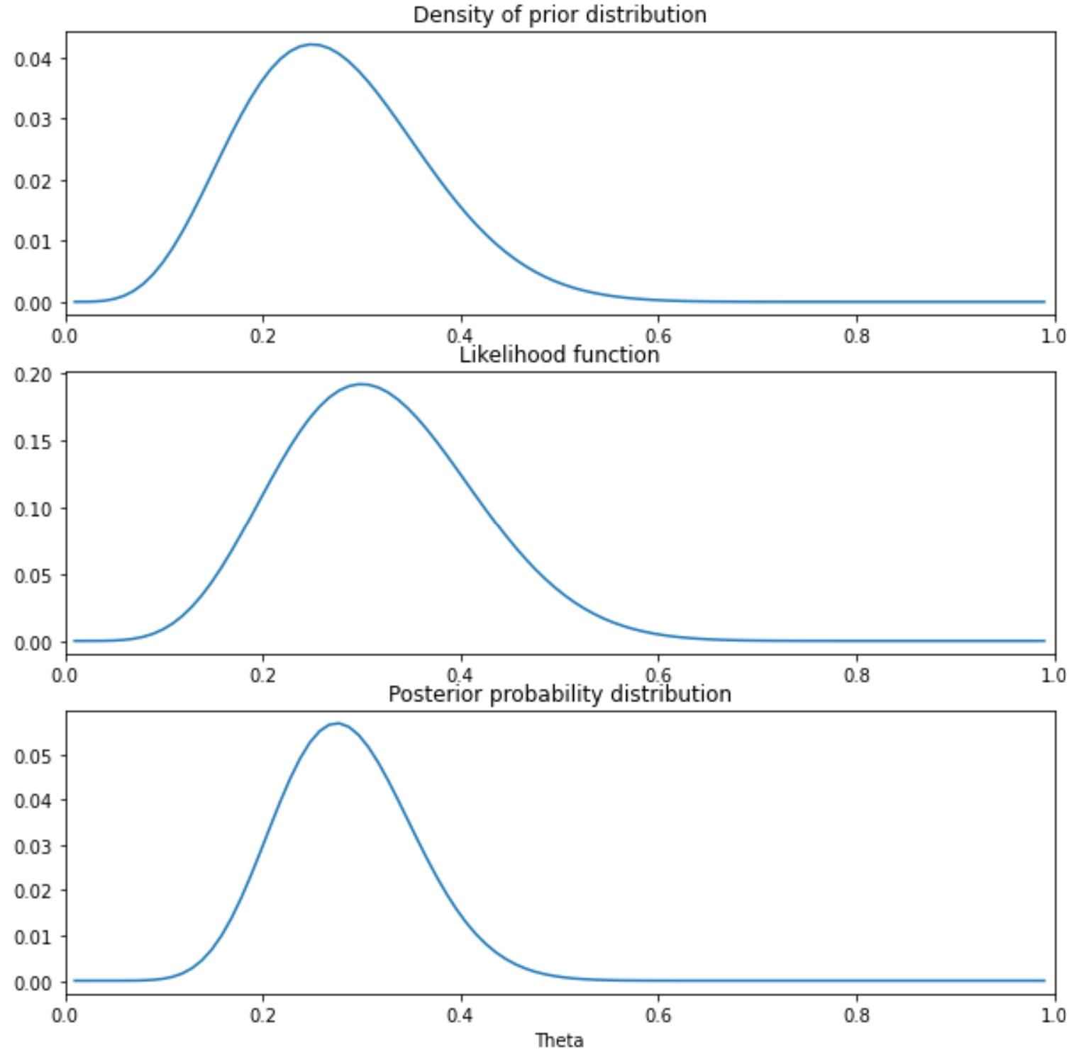
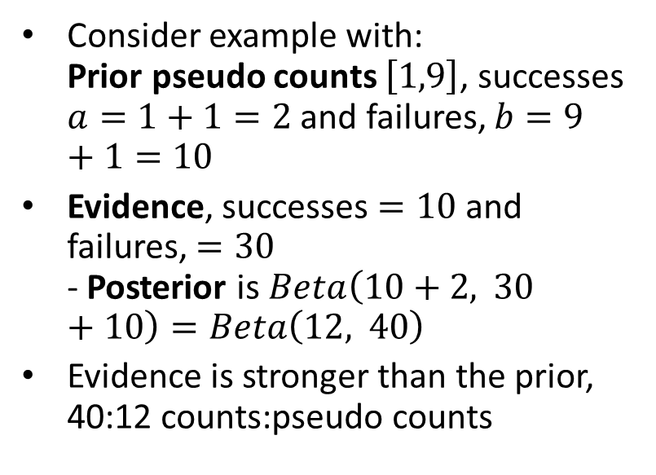
Working with a Conjugate Prior
Consider example with: Prior pseudo counts $\left[1,9\right]$, successes $a=1+1=2$ and failures, $b=9+1=10$
Evidence, successes $=10$ and failures, $=30$ - Posterior is $Beta\left(10+2, 30+10\right)=Beta\left(12, 40\right)$
Evidence is stronger than the prior, 40:12 counts:pseudo counts
Prior, likelihood and posterior for distracted driving

Slide 53
Sampling the Posterior Distribution

Slide 54
Sampling the Posterior
How can we find an empirical estimate of the posterior distribution?
We can sample from the likelihood function and prior
Sample the analytic conjugate prior if it exists
Grid sample or Markov chain Monte Carlo (MCMC) sample
Take the product of the likelihood and the prior
Normalize to compute proper posterior distribution

Slide 55
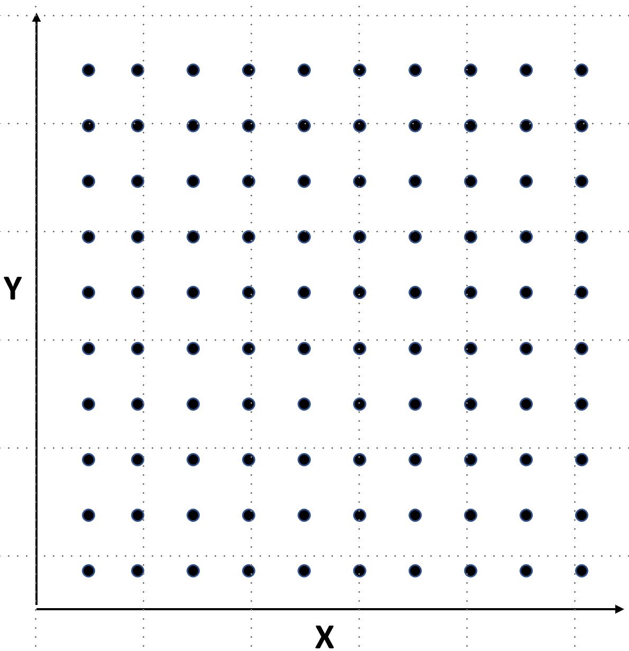
Sampling the Posterior
Grid sampling is a naive approach
Compute the probability at each point on a regular gird
Sample over range of values of interest
Take the product of the prior and likelihood
In principle grid sampling can work for any number of dimensions
In 1-dimension is just regularly spaced points on a line
Poor scaling to higher dimensions
Sampling grid for bivariate distribution

Slide 56
Sampling the Posterior
Algorithm for grid sampling to compute posterior from likelihood and prior
Procedure CreateGrid(variables, lower_limits, upper_limits): # Build the sampling grid return sampling_grid Procedure SampleLikelihood(sampling_value, observation_values): return likelihood_function(observation_values, sampling_value) Procedure Prior(sampling_values, prior_parameter_value): return prior_density_function(sampling_value, prior_parameter_values) ComputePosterior(variables, lower_limits, upper_limits): # Initialize the sampling grid Grid = CreateGrid(variables, lower_limits, upper_limits) # Initialize array to hold sampled posterior values array posterior[range(Grid)] # Compute posterior at each sampling value in the grid for sampling_value in range(lower_limits, upper_limits): likelihood = SampleLikelihood(sampling_value, observation_values) prior = Prior(sampling_values, prior_parameter_value) posterior[sampling_value] = likelihood * prior # Normalize the posterior probability_data = sum(posterior[range(Grid)]) posterior = posterior[range(Grid)]/probability_data return posterior

Slide 57
Credible Distributions

Slide 58
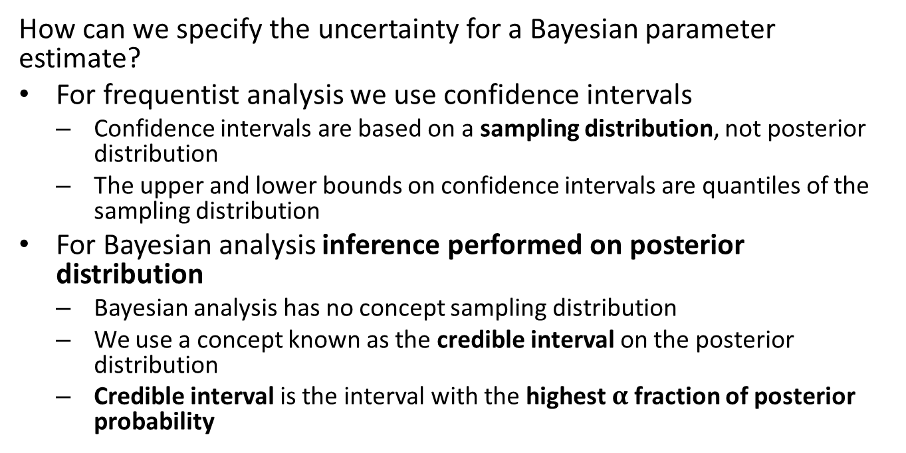
Credible Intervals
How can we specify the uncertainty for a Bayesian parameter estimate?
For frequentist analysis we use confidence intervals
Confidence intervals are based on a sampling distribution, not posterior distribution
The upper and lower bounds on confidence intervals are quantiles of the sampling distribution
For Bayesian analysis inference performed on posterior distribution
Bayesian analysis has no concept sampling distribution
We use a concept known as the credible interval on the posterior distribution
Credible interval is the interval with the highest $α$ fraction of posterior probability

Slide 59
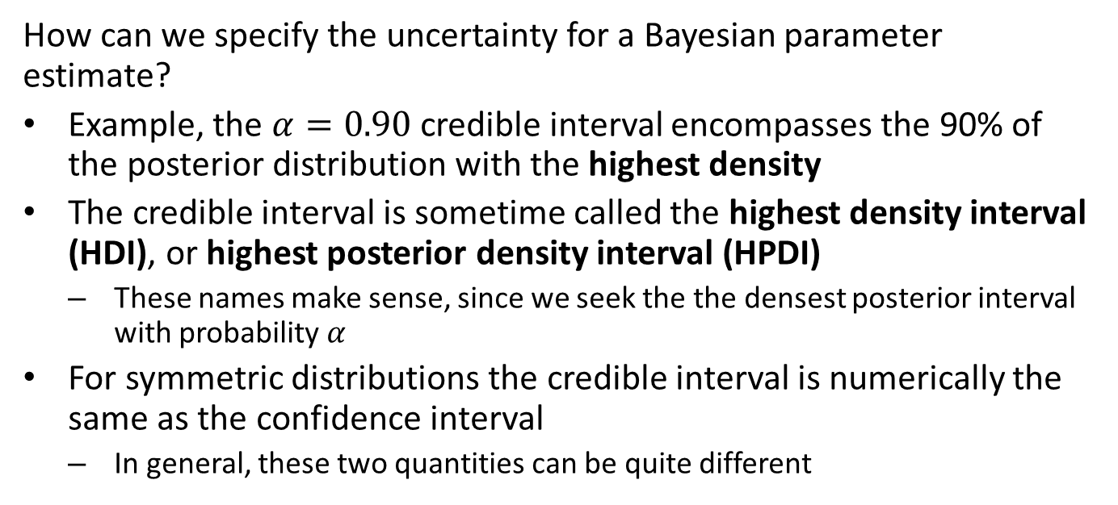
Credible Intervals
How can we specify the uncertainty for a Bayesian parameter estimate?
Example, the $α=0.90$ credible interval encompasses the 90% of the posterior distribution with the highest density
The credible interval is sometime called the highest density interval (HDI), or highest posterior density interval (HPDI)
These names make sense, since we seek the the densest posterior interval with probability $α$
For symmetric distributions the credible interval is numerically the same as the confidence interval
In general, these two quantities can be quite different

Slide 60
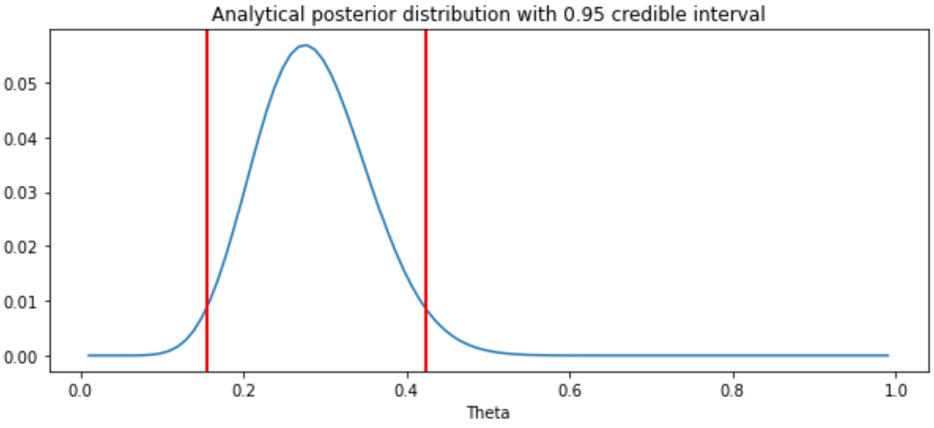
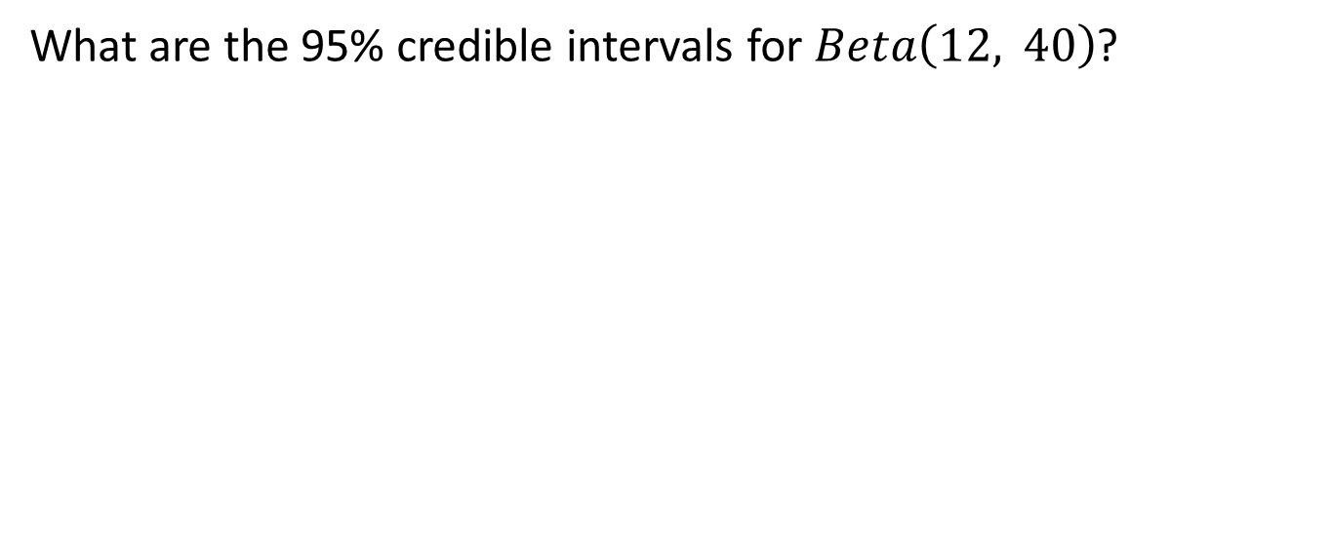
Credible Intervals
What are the 95% credible intervals for $Beta\left(12, 40\right)$?
Probability of distract drivers for next 10 cars

Slide 61
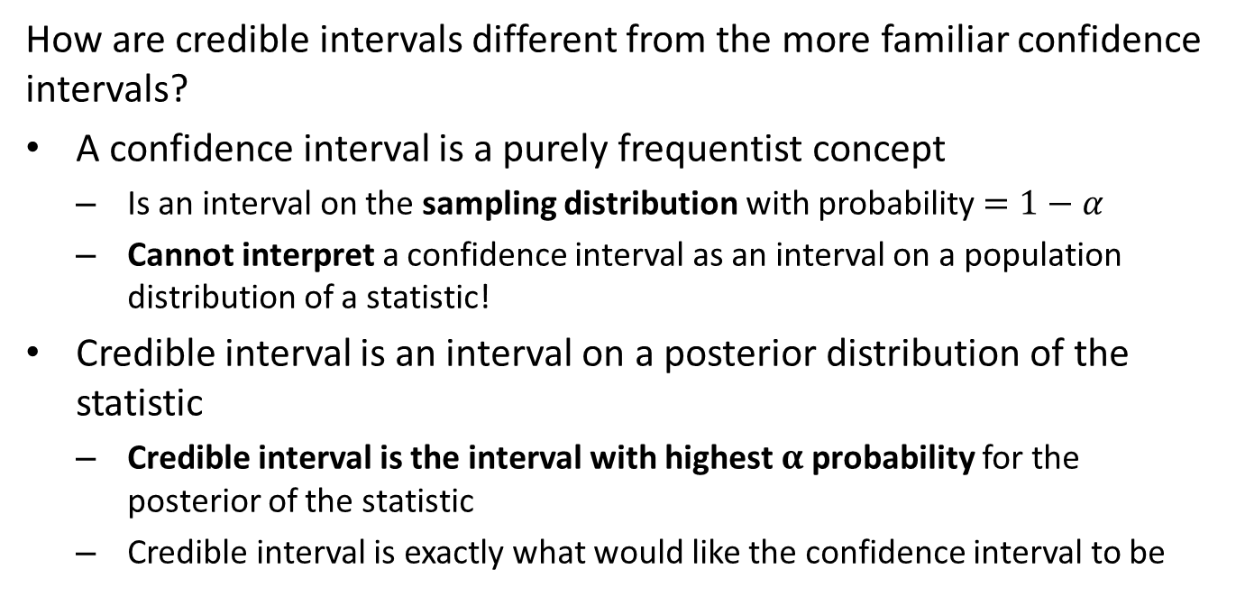
Credible Intervals are not Confidence Intervals
How are credible intervals different from the more familiar confidence intervals?
A confidence interval is a purely frequentist concept
Is an interval on the sampling distribution with probability $=1−α$
Cannot interpret a confidence interval as an interval on a population distribution of a statistic!
Credible interval is an interval on a posterior distribution of the statistic
Credible interval is the interval with highest $α$ probability for the posterior of the statistic
Credible interval is exactly what would like the confidence interval to be

Slide 62
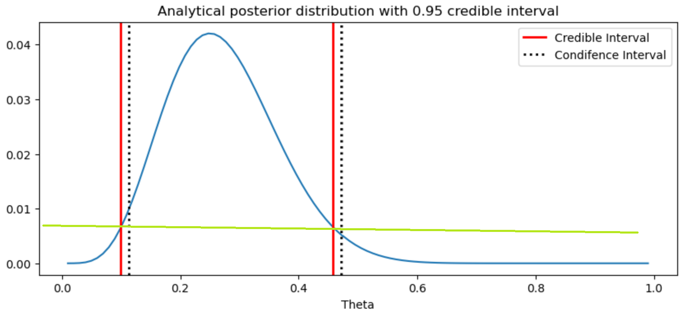
Credible Intervals are not Confidence Intervals
Compare 95% confidence interval and 95% credible interval for the case of 10 observations
Credible intervals cross the density function at exactly the same density
Confidence intervals have the same CDF in the tails beyond the interval
Difference between credible and confidence intervals

Slide 63
Simulating From the Posterior Distribution

Slide 64
Simulating from the posterior distribution: predictions
What else can we do with the Bayesian posterior distribution?
Predictions are computed by simulating from the posterior distribution
Results of these simulations are useful for several purposes, including:
Predicting posterior values
Model checking by comparing simulation results agree (or not) with observations

Slide 65
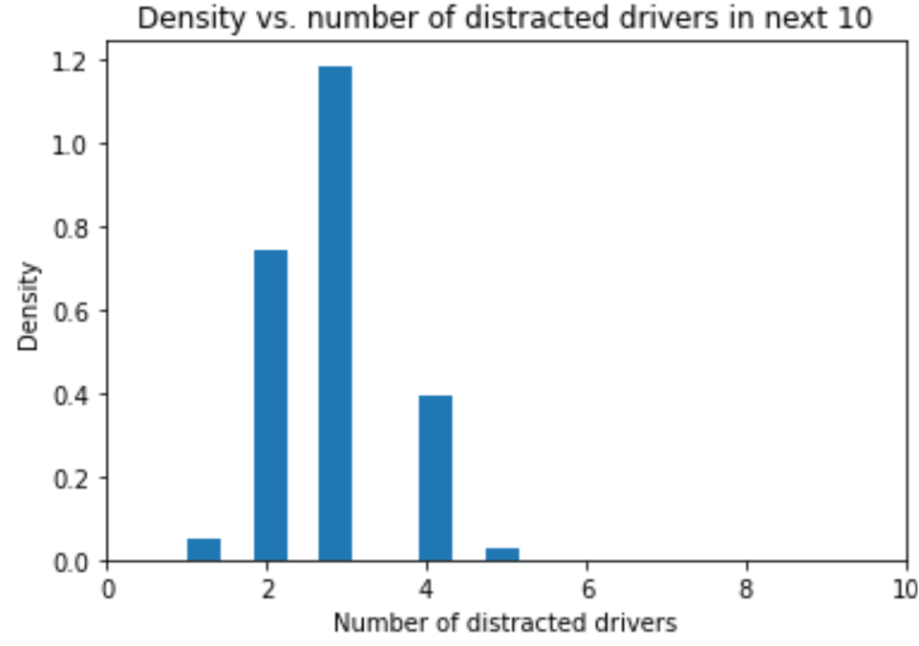
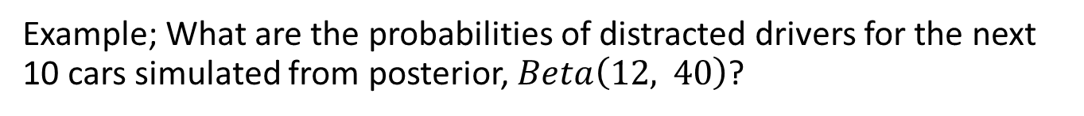
Simulating from the posterior distribution: predictions
Example; What are the probabilities of distracted drivers for the next 10 cars simulated from posterior, $Beta\left(12, 40\right)$?
Probability of distract drivers for next 10 cars

Slide 66
Summary
Bayesian analysis is a contrast to frequentist methods
The objective of Bayesian analysis is to compute a posterior distribution
Contrasts with frequentist statistics which computes a point estimate and confidence interval from a sample
Bayesian models allow expressing prior information in the form of a prior distribution
Selection of prior distributions can be performed in a number of ways
The posterior distribution is said to quantify our current belief
We update beliefs based on additional data or evidence
Inference can be performed on the posterior distribution by finding the maximum a postiori (MAP) value and a credible interval
Predictions are made by simulating from the posterior distribution

